Slide 1
SENG 1000 - Software Engineering Foundations and Practice
-Sumati

Slide 2
Topics
Python for Data Analysis
What Is Data Analytics?
Overview of Python Libraries for Data Scientists
Reading Data; Selecting and Filtering the Data; Data manipulation, sorting, grouping, rearranging
Plotting the data
Descriptive statistics
Inferential statistics

Slide 3
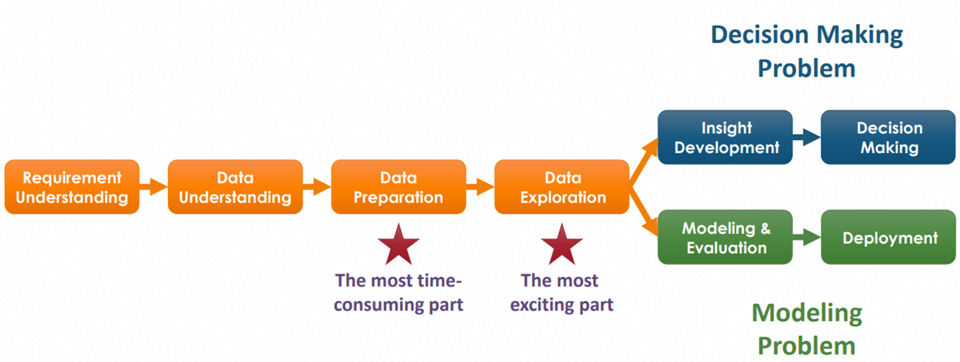
What Is Data Analytics? & Why Is It So Popular?
Data analytics is the process and methodology of analyzing data to draw meaningful insight from the data
for gaining critical insight by applying data analyticsWe now see the limitless potential

Slide 4
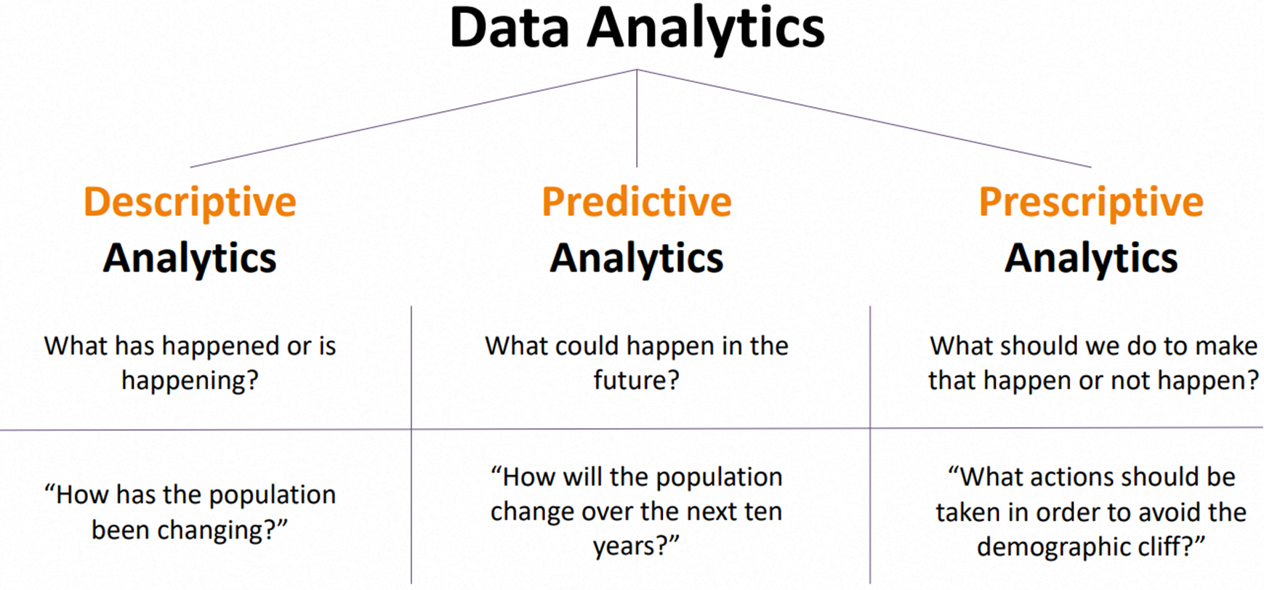
Types of Data Analytics

Slide 5
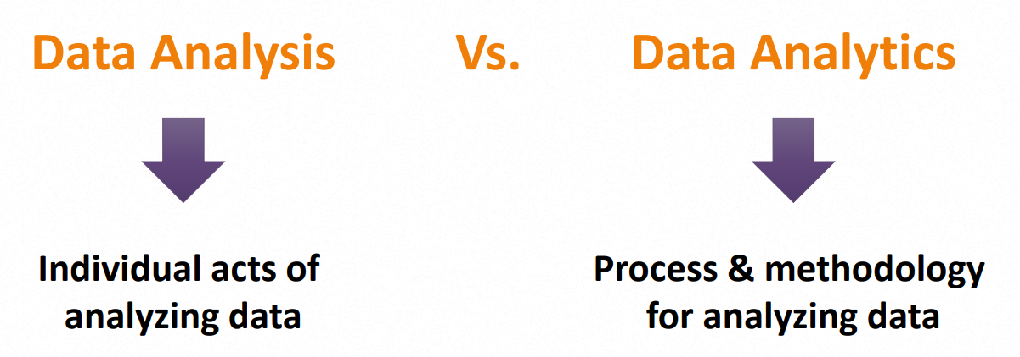
Confusion – Data Analysis vs. Data Analytics
They’re often used interchangeably, but technically speaking…

Slide 6
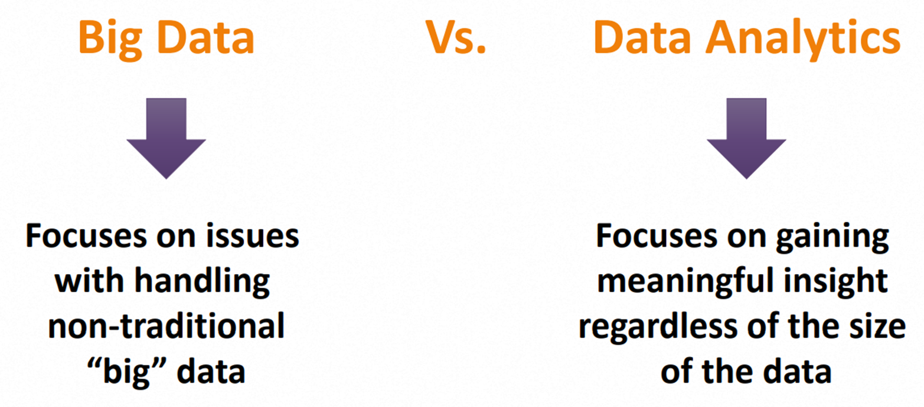
Confusion – Big Data vs. Data Analytics
What they have in common is that both refer to data, but technically speaking…

Slide 7
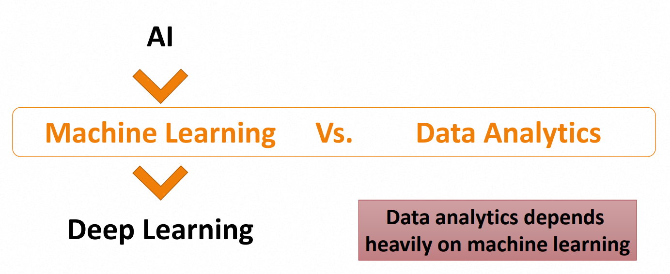
Confusion – Machine Learning vs. Data Analytics

Slide 8
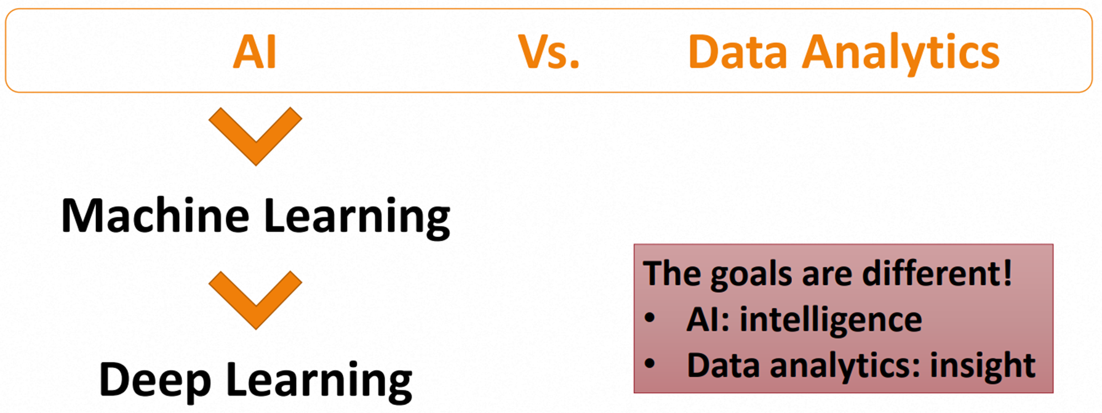
Confusion –AI vs. Data Analytics

Slide 9
Advanced Python Programming Features
Web development
Networking
Scientific computing
Data analytics
etc.

Slide 10
Python as a Data Analytics Tool
The nature of Python makes it a perfect-fit for data analytics
Easy to learn
Readable
Scalable
Extensive set of libraries
Easy integration with other apps
Active community & ecosystem

Slide 11
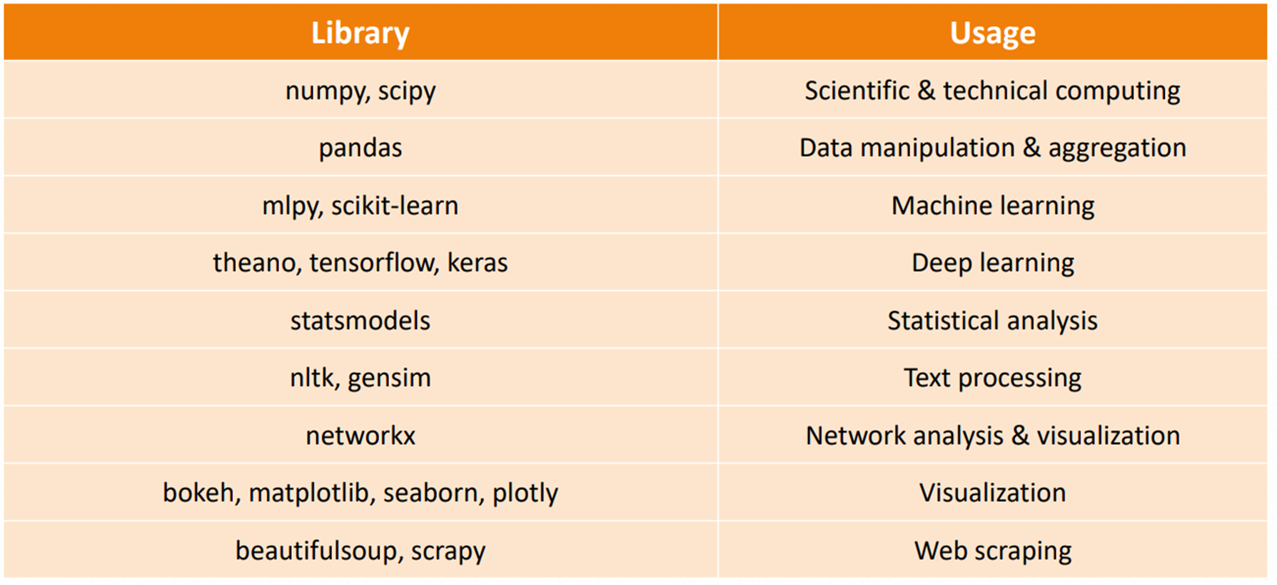
Popular Python Data Analytics Libraries

Slide 12
Comparison – R vs. Python
Comparison between R and Python has been absolutely one of the hottest topics in data science communities
R came from the statisticians community, whereas Python came from the computer scientists community
Python is said to be a challenger against R, but in general it’s a tie
It’s up to you to choose the one that best fits your needs
For detailed comparison, refer to https://www.datacamp.com/community/tutorials/r-or-python-for-data-analysis

Slide 13

Python Libraries for Data Science
Many popular Python toolboxes/libraries:
NumPy
SciPy
Pandas
SciKit-Learn
Visualization libraries
matplotlib
Seaborn
and many more …

Slide 14
Python Libraries for Data Science
NumPy:
introduces objects for multidimensional arrays and matrices, as well as functions that allow to easily perform advanced mathematical and statistical operations on those objects
provides vectorization of mathematical operations on arrays and matrices which significantly improves the performance
many other python libraries are built on NumPy
Link: http://www.numpy.org/
Find, install and publish Python package with the Python Package Index: https://pypi.org/

Slide 15
Python Libraries for Data Science
SciPy:
collection of algorithms for linear algebra, differential equations, numerical integration, optimization, statistics and more
part of SciPy Stack
built on NumPy
Link: https://www.scipy.org/scipylib/

Slide 16
Python Libraries for Data Science
Pandas:
adds data structures and tools designed to work with table-like data (similar to Series and Data Frames in R)
provides tools for data manipulation: reshaping, merging, sorting, slicing, aggregation etc.
allows handling missing data
Link: http://pandas.pydata.org/

Slide 17
Python Libraries for Data Science
SciKit-Learn:
provides machine learning algorithms: classification, regression, clustering, model validation etc.
built on NumPy, SciPy and matplotlib
Link: http://scikit-learn.org/

Slide 18
Python Libraries for Data Science
matplotlib:
python 2D plotting library which produces publication quality figures in a variety of hardcopy formats
a set of functionalities similar to those of MATLAB
line plots, scatter plots, barcharts, histograms, pie charts etc.
relatively low-level; some effort needed to create advanced visualization
Link: https://matplotlib.org/

Slide 19
Python Libraries for Data Science
Seaborn:
based on matplotlib
provides high level interface for drawing attractive statistical graphics
Similar (in style) to the popular ggplot2 library in R
Link: https://seaborn.pydata.org/

Slide 20
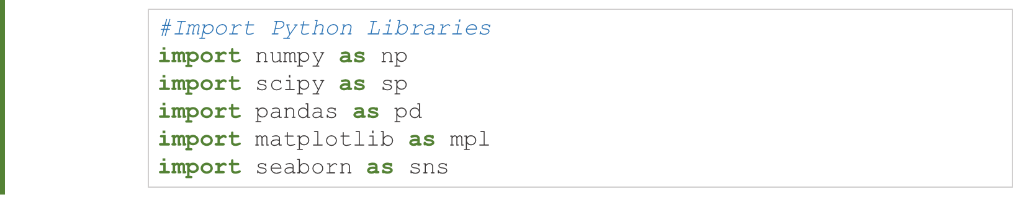
Loading Python Libraries

Slide 21
Reading data using pandas
There is a number of pandas commands to read other data formats:
pd.read_excel('myfile.xlsx',sheet_name='Sheet1', index_col=None, na_values=['NA'])
pd.read_stata('myfile.dta')
pd.read_sas('myfile.sas7bdat')
pd.read_hdf('myfile.h5','df')
Not for exam

Slide 22
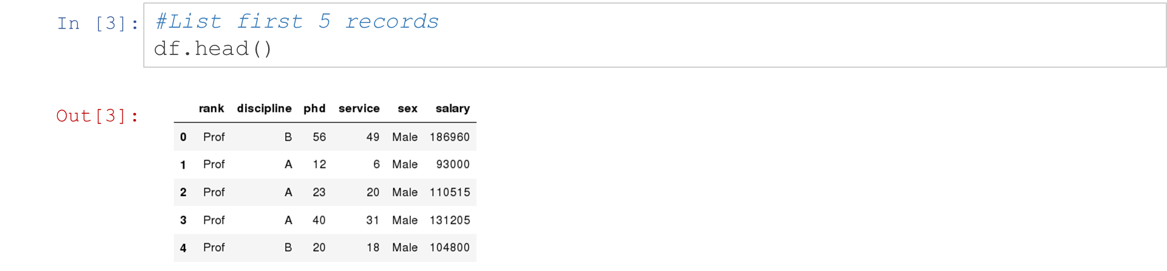
Exploring data frames
Not for exam

Slide 23
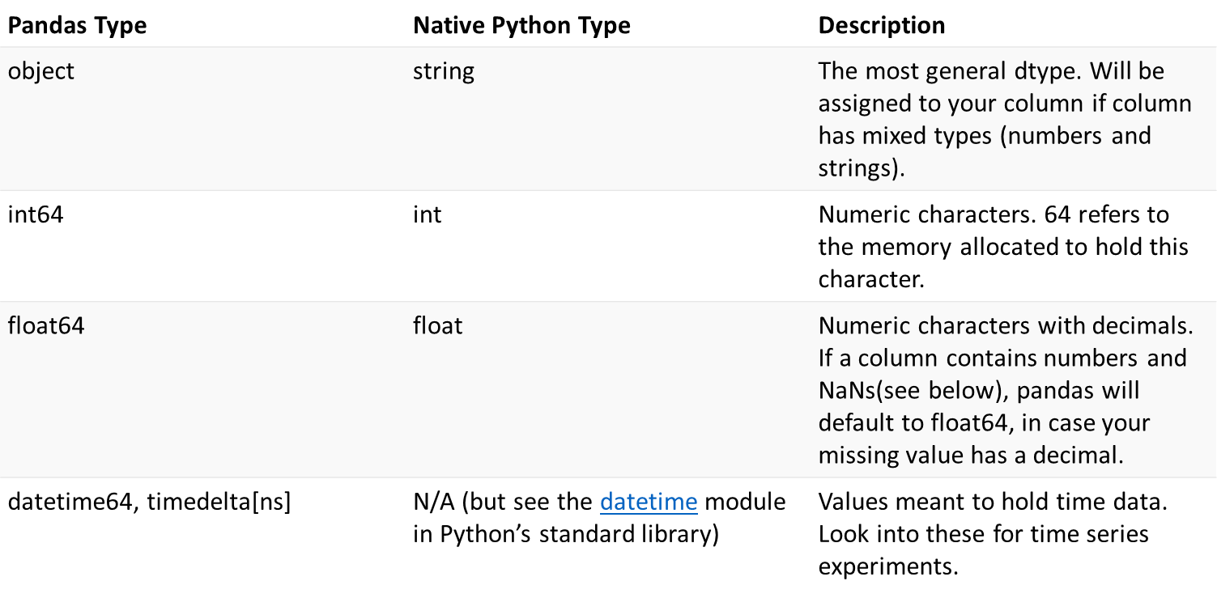
Data Frame data types
Not for exam

Slide 24
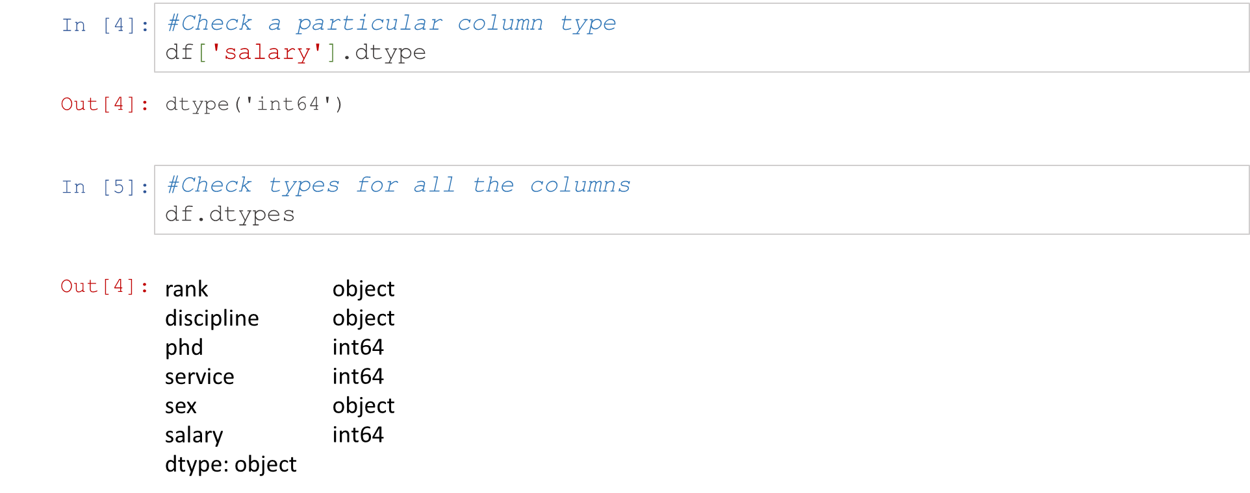
Data Frame data types
Not for exam

Slide 25
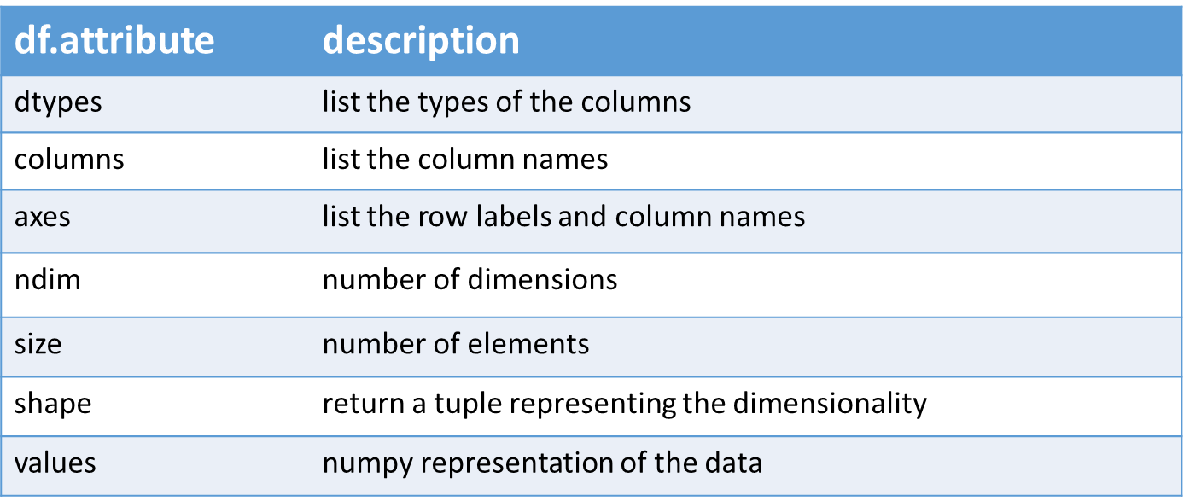
Data Frames attributes
Python objects have attributes and methods.
Not for exam

Slide 26
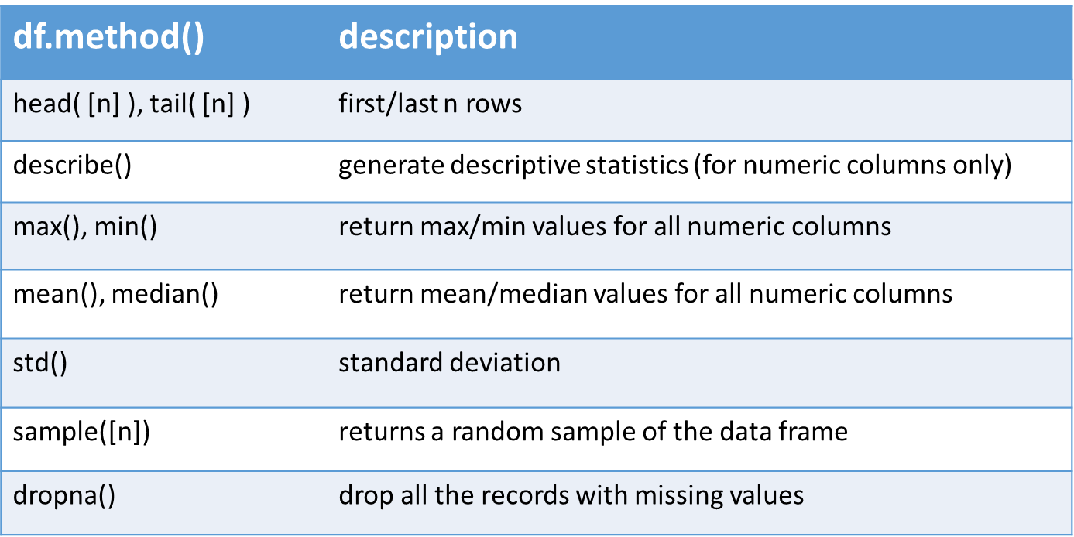
Data Frames methods
Unlike attributes, python methods have parenthesis.
All attributes and methods can be listed with a dir() function: dir(df)
Not for exam

Slide 27
Selecting a column in a Data Frame
Method 1: Subset the data frame using column name:
df['sex']
Method 2: Use the column name as an attribute:
df.sex
Note: there is an attribute rank for pandas data frames, so to select a column with a name "rank" we should use method 1.
Not for exam

Slide 28
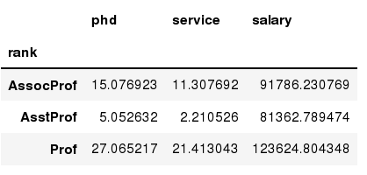
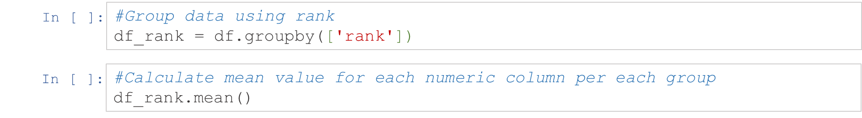
Data Frames groupby method
Using "group by" method we can:
Split the data into groups based on some criteria
Calculate statistics (or apply a function) to each group
Similar to dplyr() function in R
Not for exam

Slide 29
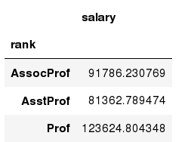
Data Frames groupby method
Once groupby object is create we can calculate various statistics for each group:
Not for exam

Slide 30
Data Frames groupby method
groupby performance notes:
no grouping/splitting occurs until it's needed. Creating the groupby object only verifies that you have passed a valid mapping
by default the group keys are sorted during the groupby operation. You may want to pass sort=False for potential speedup:
Not for exam

Slide 31
Data Frame: filtering
To subset the data we can apply Boolean indexing. This indexing is commonly known as a filter. For example if we want to subset the rows in which the salary value is greater than $120K:
Any Boolean operator can be used to subset the data:
> greater; >= greater or equal;
< less; <= less or equal;
== equal; != not equal;
Not for exam

Slide 32
Data Frames: Slicing
There are a number of ways to subset the Data Frame:
one or more columns
one or more rows
a subset of rows and columns
Rows and columns can be selected by their position or label
Not for exam

Slide 33
Data Frames: Slicing
When selecting one column, it is possible to use single set of brackets, but the resulting object will be a Series (not a DataFrame):
When we need to select more than one column and/or make the output to be a DataFrame, we should use double brackets:
Not for exam

Slide 34
Data Frames: Selecting rows
If we need to select a range of rows, we can specify the range using ":“
Notice that the first row has a position 0, and the last value in the range is omitted:
So for 0:10 range the first 10 rows are returned with the positions starting with 0 and ending with 9
Not for exam

Slide 35
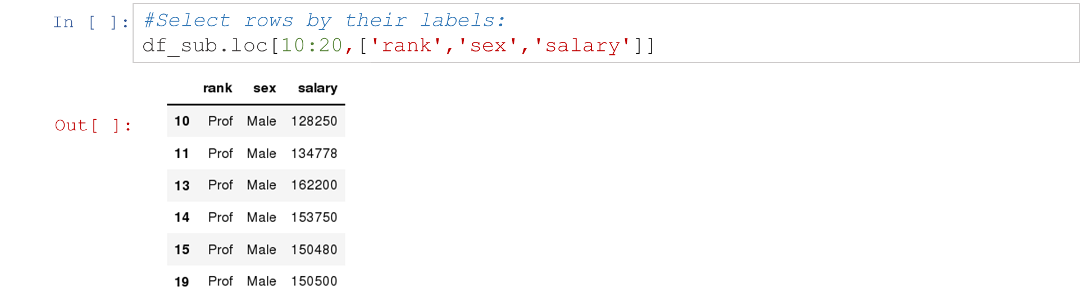
Data Frames: method loc
If we need to select a range of rows, using their labels we can use method loc:
Not for exam

Slide 36
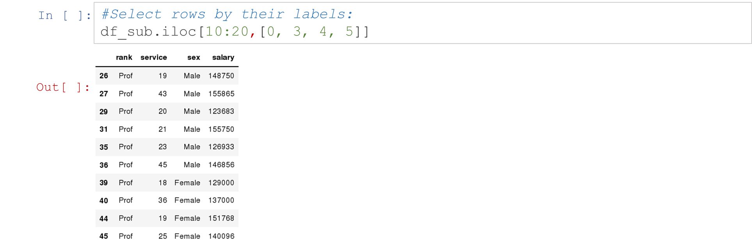
Data Frames: method iloc
If we need to select a range of rows and/or columns, using their positions we can use method iloc:
Not for exam

Slide 37
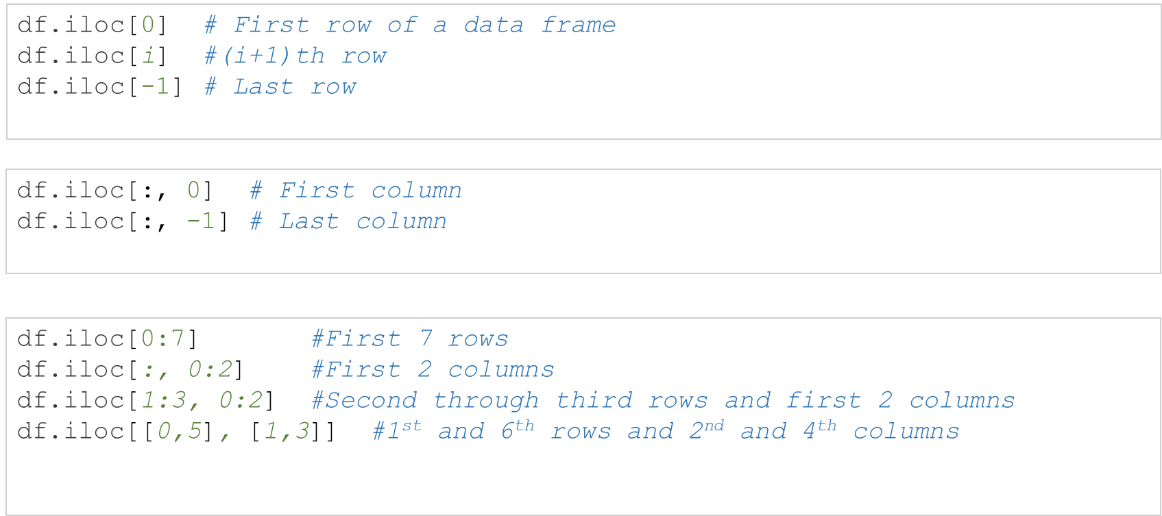
Data Frames: method iloc (summary)
Not for exam

Slide 38
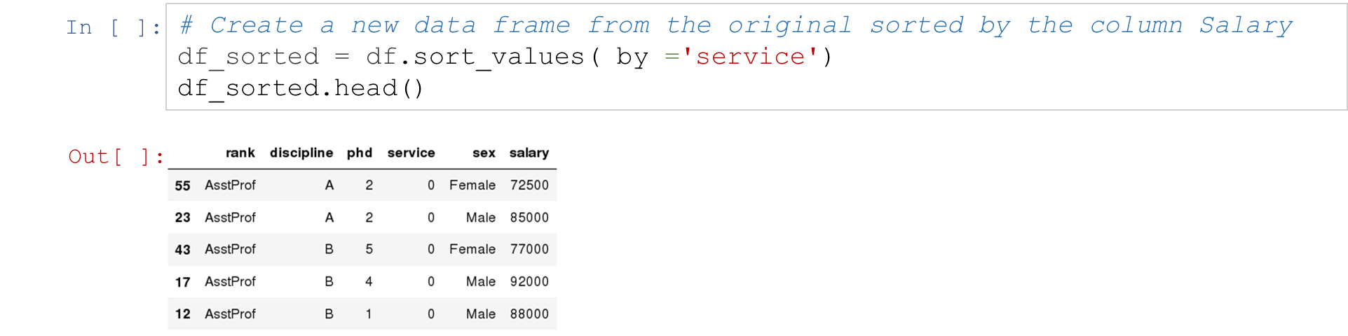
Data Frames: Sorting
We can sort the data by a value in the column. By default the sorting will occur in ascending order and a new data frame is return.
Not for exam

Slide 39
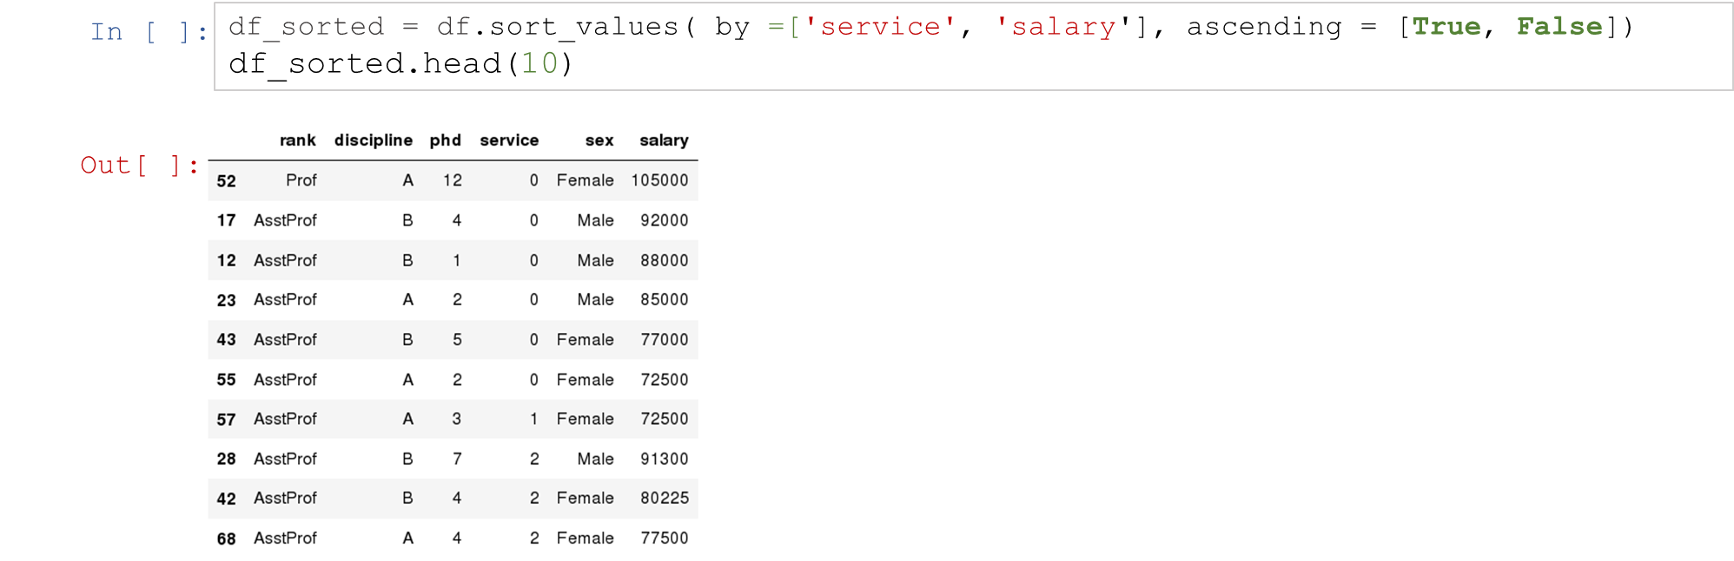
Data Frames: Sorting
We can sort the data using 2 or more columns:
Not for exam

Slide 40
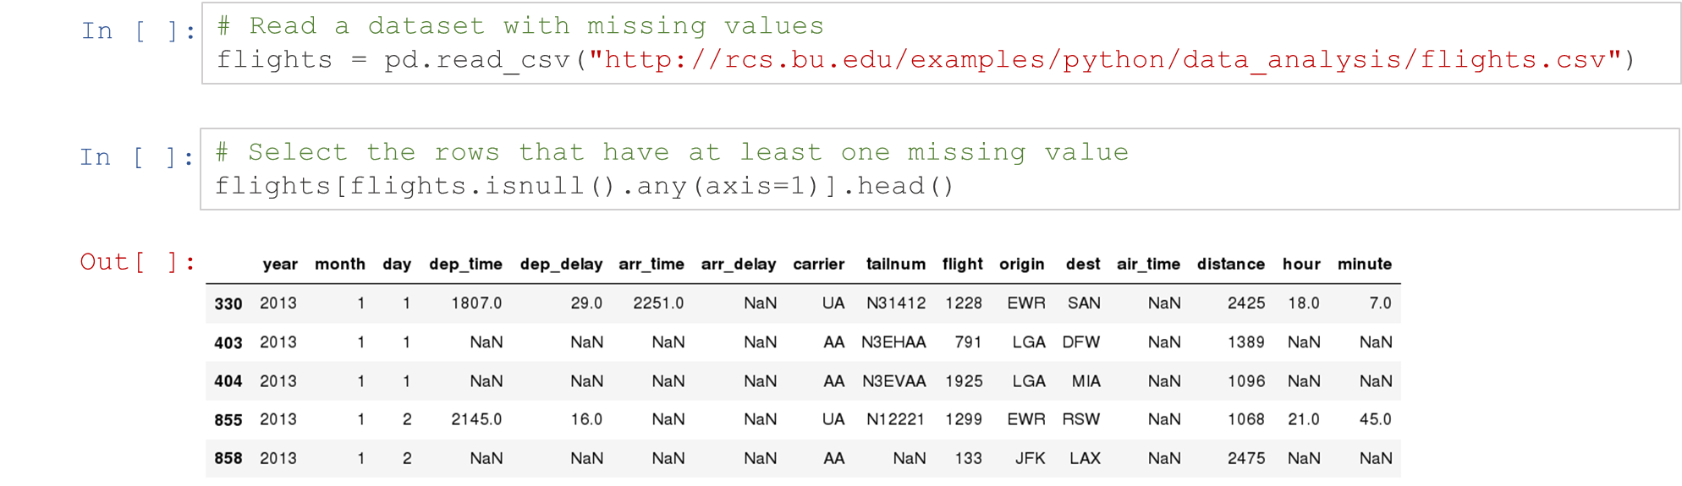
Missing Values
Missing values are marked as NaN
Not for exam

Slide 41
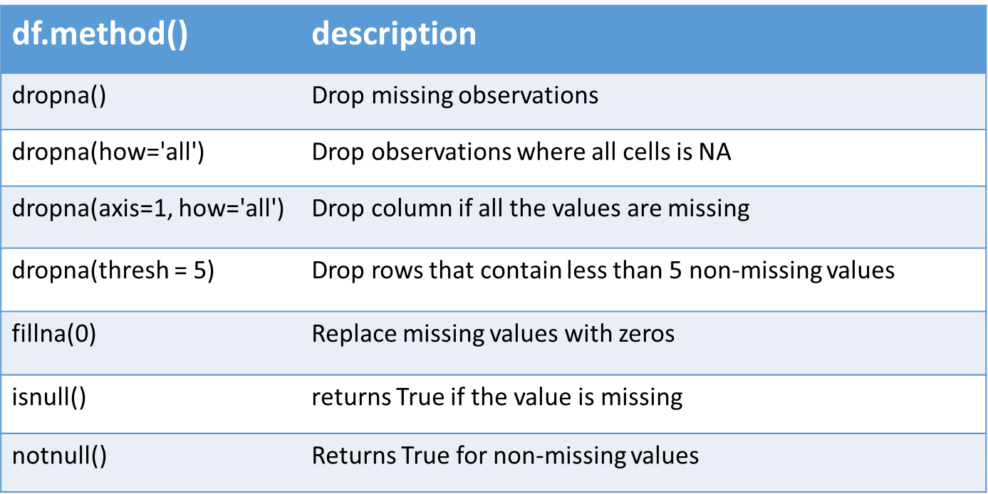
Missing Values
There are a number of methods to deal with missing values in the data frame:
Not for exam

Slide 42
Missing Values
When summing the data, missing values will be treated as zero
If all values are missing, the sum will be equal to NaN
cumsum() and cumprod() methods ignore missing values but preserve them in the resulting arrays
Missing values in GroupBy method are excluded (just like in R)
Many descriptive statistics methods have skipna option to control if missing data should be excluded . This value is set to True by default (unlike R)
Not for exam

Slide 43
Aggregation Functions in Pandas
Aggregation - computing a summary statistic about each group, i.e.
compute group sums or means
compute group sizes/counts
Common aggregation functions:
min, max
count, sum, prod
mean, median, mode, mad
std, var
Not for exam

Slide 44
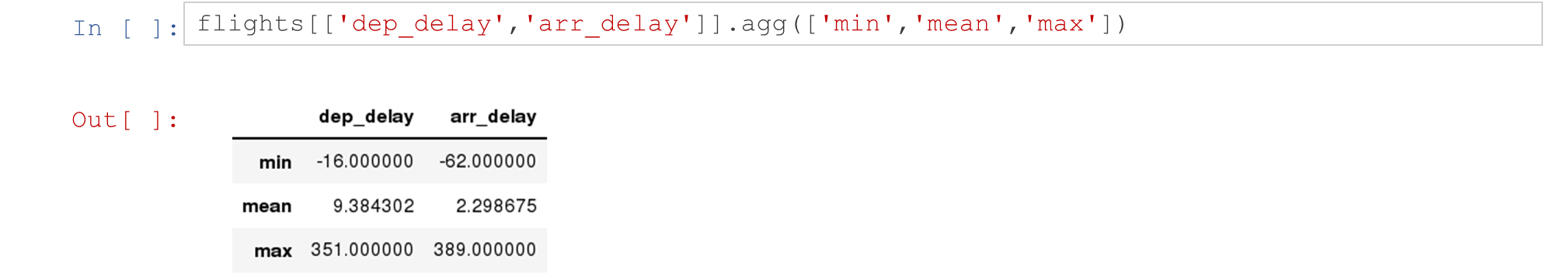
Aggregation Functions in Pandas
agg() method are useful when multiple statistics are computed per column:
Not for exam

Slide 45
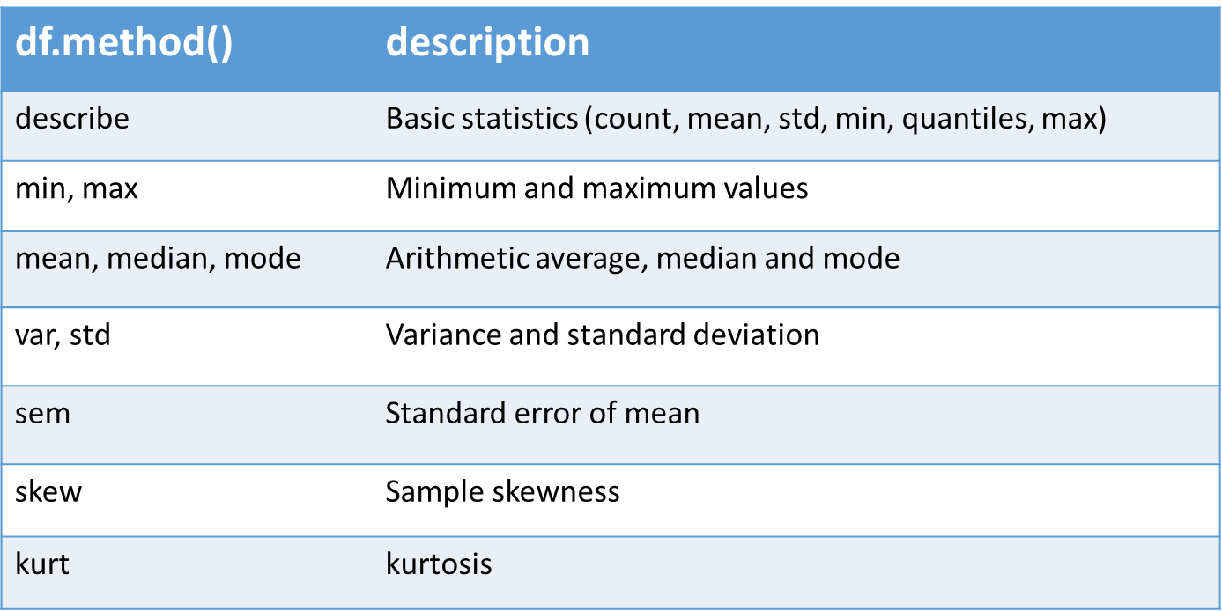
Basic Descriptive Statistics
Not for exam

Slide 46
Graphics to explore the data
Seaborn package is built on matplotlib but provides high level interface for drawing attractive statistical graphics, similar to ggplot2 library in R. It specifically targets statistical data visualization
To show graphs within Python notebook include inline directive:
Not for exam

Slide 47
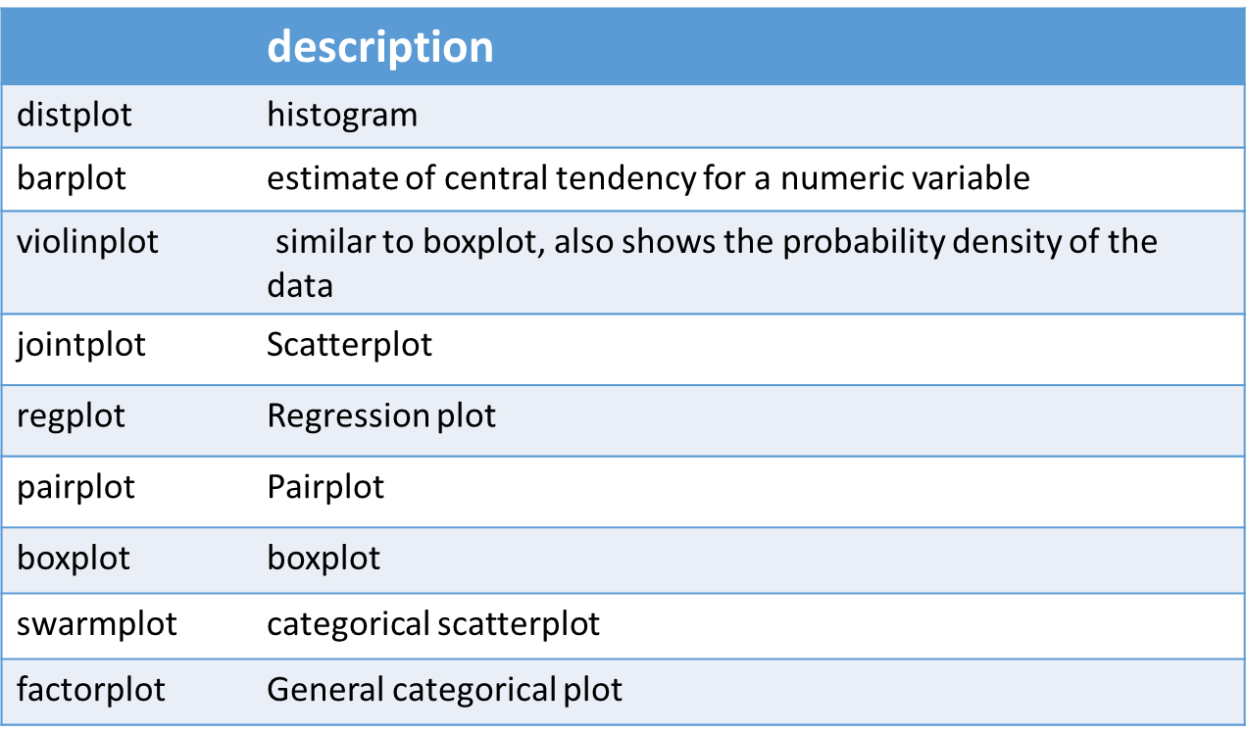
Graphics
Not for exam

